Slide 1
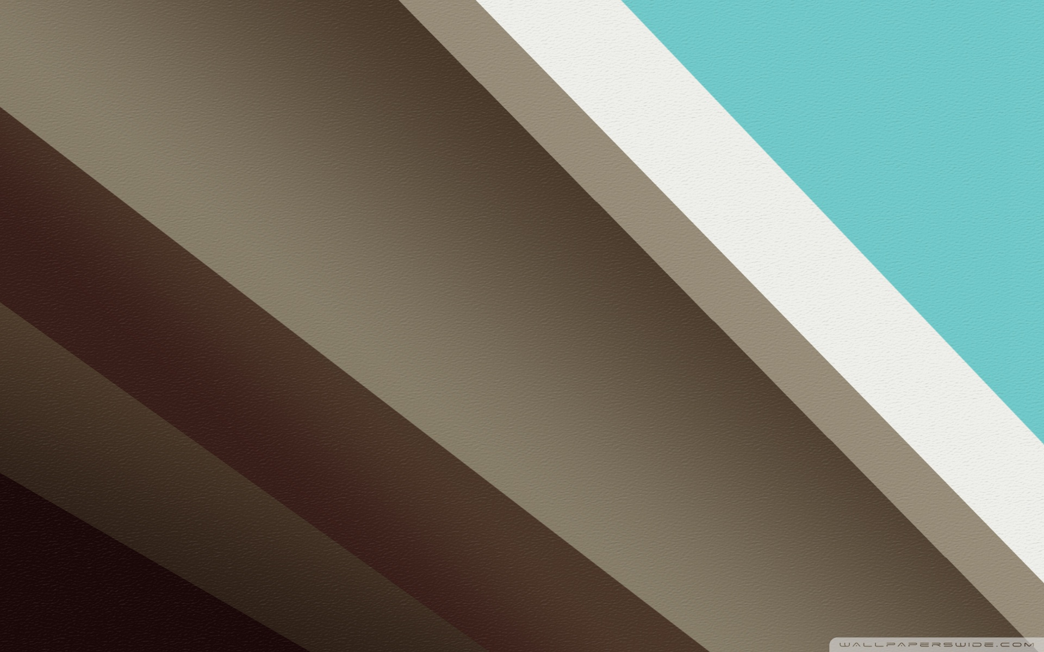
Material Design
A Live Demo Made by PowerPoint

Slide 2
Meaningful Transitions
From somewhere, to somewhere

Slide 3
Meaningful Transitions
So,
From somewhere, to somewhere
… is a clearer way to show the user “what is going on”.

Slide 4

Floating Action Button
Is the most eye-attracting element on the screen.
Should have the most frequently-used function in the current activity.

Slide 5
Thank you!
Lyndon Pan, 12/2014

